Slide 1
Review of Tips & Tricks
Becoming Better Writers
Notes:
Introduce myself
My credentials
Refer to Quote

Slide 2
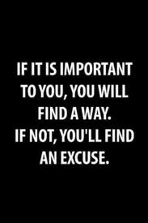
Working hard, being dedicated – pays off.

Slide 3
A Quick Guide
Notes:
Just for fun…

Slide 4
The Rubric
Notes:
Bring rubric up from Word Doc – use the hyperlink
Briefly review key words that differentiates the “6” column from the others
Remember who your audience is – this is a formal piece – an academic essay

Slide 5
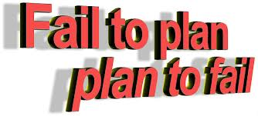
Organization: Planning – Don’t Write Without It
Notes:
Before you can plan, you need to identify key words from the prompt to determine which type of prompt – organizational pattern, and stylistic techniques are needed.

Slide 6
Exposition vs. Persuasion
Expository writing
has a narrow topic.
stays focused on the main ideas.
is elaborated using reasons, well-chosen and specific details, examples, and/or anecdotes to support ideas.
includes information that is interesting, thoughtful, and necessary for the audience.
is organized with an introduction, supporting paragraphs with main points and elaboration, and an effective conclusion.
uses transitions to connect ideas.
shows commitment to topic with voice and language appropriate for audience and purpose.
uses specific words and phrases that help the reader understand ideas.
Notes:
This is the same as the expository writing checklist found in the student booklet of the WASL.
Some students are not certain about the differences between persuasive writing and expository writing. Discuss the slide with your students, identifying the characteristics of expository writing prior to identifying what is distinctive to persuasion, so you’ll have a basis for comparison.

Slide 7
Graphic Organizers - A Writer’s Best Friend
CLAIM: Duct tape is the most ingenious and versatile tool ever invented.
PREMISE #1 -vital to national security | PREMISE #2 -medical miracle | PREMISE #3 -fashion statement
Evidence/Examples/Anecdote | Evidence/Examples/Anecdote | Evidence/Examples/Anecdote
THESIS STATEMENT: Duct tape is the most ingenious and versatile tool ever invented because it’s vital to national security, it’s a medical miracle, and it’s a fashion statement.

Slide 8
Exposition vs. Persuasion
Persuasive writing
has a clear position and is focused on that position.
has more than one argument to support a position.
is elaborated by using reasons, well-chosen and specific details, examples, anecdotes, facts, and/or statistics as evidence to support arguments.
is organized to make the best case for a position.
anticipates and refutes the opposing position.
begins with an opening, including a statement of position, and ending with an effective persuasive conclusion, such as a call for action.
uses transitions to connect position, arguments, and evidence.
shows commitment to position by writing in a voice appropriate for audience and purpose.
uses words, phrases, and persuasive strategies that urge or compel the reader to support a position.
Notes:
This is the same as the persuasive writing checklist found in the student booklet of the WASL. There is a copy in the document folder (WASL gr 10 pers checklist.doc).
Compare the characteristics of persuasion to those of exposition (on the previous slide). Have students find key characteristics of persuasion and differences between expository and persuasive writing.
Note to teachers: For the purpose of the WASL, students should be writing to persuade rather than to argue. Students sometimes confuse these two. The key difference between these two approaches is that persuasive writing begins with a stance or a truth, where argumentation may lead to a solution or an opinion on how to solve an identified problem.
Persuasive Writing (the writer knows a truth) results in an action or actions bringing about a desired response. The writer already has a solution in mind.
Argumentative Writing (the writer discovers a truth) results in developing a conviction or making a case for a judgment or opinion. The writer discovers or explores a solution, using evidence-based reasoning to create new knowledge or find common ground.

Slide 9
Graphic Organizers - A Writer’s Best Friend
QUESTION: Should gun control be further tightened?
PRO - YES | CON - NO
Reasons/Evidence/Examples/Anecdote 30,000 Americans die each year from guns 40,000 are injured in gun-related activities Cost our nation billions of $ in medical and other expenses | Reasons/Evidence/Examples/Anecdote 99% of gun owners use them responsibly to protect themselves Specific Example/Anecdote: Los Angeles riots of 1992 Survival depended on their ability to defend themselves
THESIS STATEMENT: Pro | THESIS STATEMENT: Con
Although many citizens believe they should have the right to own a gun to protect themselves, due to the fact that thousands of Americans die each year from guns, thousands more are injured in gun-related activities, and our nation’s deficit increases by billions of dollars to cover medical and other expenses, it is imperative our nation implements tighter gun control.
Notes:
Brainstorm the pros and cons
-keep in mind the three rhetorical appeals
Build ethos by recognizing both sides of an argument.
~ but remember to take a clear stand

Slide 10
Recognize the Opposition - BUT Take a CLEAR Stand
Notes:
Brainstorm the pros and cons
-keep in mind the three rhetorical appeals
Build ethos by recognizing both sides of an argument.
~ but remember to take a clear stand

Slide 11
Tips to Remember When Planning & Writing Support
Six Strategies for Making Your Writing More Convincing
Be specific
Only include ideas you can support
Establish credibility
Acknowledge counterarguments
Avoid absolutes
Be respectful to your audience
BONUS: Do not write about your writing – just write.
DOUBLE BONUS: Avoid the obvious
Notes:
Don’t put anyone down – even yourself

Slide 12
Organizational Structures: Persuasive
Persuasive Writing - High School - PowerPoint
Notes:
Note: Organizational structures are presented prior to introductions and conclusions so the students will have a working draft from which they can write the introductions and conclusions. Students often need the body of the paper drafted before they can apply a variety of introduction or conclusion strategies.
Each of the six lessons includes transitional phrases that target the different organizational structures. In the document folder, you will find a page with all of the transitions listed (transitional phrases.doc). You may want to duplicate it for your students.
You will note that these structures are taught as writing lessons, rather than activities. Feel free to adapt the amount of writing that is done; students could revise one paper, they could write paragraphs, or these lessons could be interspersed throughout the year. If students don’t understand a particular strategy, the lesson will need to be extended or repeated.
The six structures that are presented are not all-inclusive. They are suggestions based on some of the structures that have been successfully used on the WASL. Structures are often used in combination. They are not intended to be mandated or formulaic patterns.
Students should have many options so that they may select an appropriate organizational structure for a specific purpose.

Slide 13
Persuasive Organizational Structures
Order of importance
Topics are prioritized from most to least or least to most
Causal chain
A culminating chain of events where one thing leads to the next (snowball or domino effect)
Notes:
Organization in persuasive writing (3 slides)
Definitions for each of the structure types are on the presentation slides and in the document folder (Org Structures def.doc).
Provide students with hard copies of structures, or, you could display the samples provided on a document camera and have students take notes.
Review with students these definitions.

Slide 14
Persuasive Organizational Structures
Concession/Rebuttal Organization
Acknowledging or recognizing the opposing viewpoint
Conceding something that has some merit
Then countering with another argument

Slide 15
Persuasive Organizational Structures
Cause/effect
Explain why something happened, and what came about as a result.
Problem/solution
Explain the problem or issue, and suggest how it can be solved.
Definition
Define the elements of a concept, and explain how, or whether or not, your definition fits.
Combination
Effective papers often use a combination of several structures.

Slide 16
FOCUS ~ Reflect Insight
The Rule of “So What?” – Good writing in every genre answers the question, “SO WHAT?” Good writing has a purpose, a point, a reason it was written. The good writer looks for and finds the meanings, the significances, the implications in the subject he or she has chosen. Sometimes, the SO WHAT? is subtle and implicit. Sometimes it’s explicitly stated. But always a good writer gives the reader something to think about.
Robert Frost wrote, “No tears for the writer, no tears for the reader.” If you don’t find the deep meanings in your life or your characters’ lives, your readers won’t find meanings in your writing. A good writer often discovers the SO WHAT? through the thinking of the writing process.
Notes:
PLAN – essential ~ do not skip this step

Slide 17
Imitation is the sincerest form of flattery. Charles Caleb Colton
Notes:
Refer back to the quote by Steven King
You become a better writer not only by writing a lot, but by reading a lot
By “Reading Like a Writer”, you pick up their style, their craft of writing – their syntax and diction

Slide 18
FOCUS: Reflect Insight
Mentor Text:
It was about forty yards to the gallows. I watched the bare brown back of the prisoner marching in front of me. He walked clumsily with his bound arms, but quite steadily, with that bobbing gait of the Indian who never straightens his knees. At each step his muscles slid neatly into place, the lock of hair on his scalp danced up and down, his feet printed themselves on the wet gravel. And once, in spite of the men who gripped him by each shoulder, he stepped slightly aside to avoid a puddle on the path.
It is curious, but till that moment I had never realized what it means to destroy a healthy, conscious man. When I saw the prisoner step aside to avoid the puddle, I saw the mystery, the unspeakable wrongness, of cutting a life short when it is in full tide. This man was not dying, he was alive just as we were alive. All the organs of his body were working--bowels digesting food, skin renewing itself, nails growing, tissues forming--all toiling away in solemn foolery. His nails would still be growing when he stood on the drop, when he was falling through the air with a tenth of a second to live. His eyes saw the yellow gravel and the gray walls, and his brain still remembered, foresaw, reasoned--reasoned even about puddles. He and we were a party of men walking together, seeing, hearing, feeling, understanding the same world; and in two minutes, with a sudden snap, one of us would be gone--one mind less, one world less.
("A Hanging" by George Orwell)
Notes:
Remember to use anecdotes as a GRABBER – not the whole intro.
Add your thesis statement – use the anecdote to illustrate your point – not BE your point
In the following two paragraphs, which appear midway through "A Hanging," the narrator shifts his point of view from that of a disinterested observer to one who identifies intimately with the prisoner. In classical terms, this sort of identification is known as ethopoeia. {rom "A Hanging" (1931) by George Orwell
Show/reflect depth-of-thinking
Avoid the Obvious
Also shows
Complex syntax & strong, vivid diction
Expanded Moment
Specific Details for Effect
Tetracolon Climax

Slide 19
ORGANIZATION & SUBSTANTIAL SUPPORT
MATURE TRANSITIONS - THROUGHOUT THE ESSAY:
INDEED, there is a different way to live life, at least for Belle. Unlike many women, Belle is not one to be influenced by appearances, good or bad. She is not impressed with Gaston’s impressive looks or rippled muscles (because he is, after all, “Perfect, a pure paragon”). Instead of dreaming about being Gaston’s wife, Belle is more interested in enjoying life, taking care of her father, and being true to herself. She does not fall into the trap of liking the cool guy, just because everyone else does. She knows that Gaston is “handsome all right, and rude and conceited and” not for her. ANOTHER EXAMPLE of Belle’s passiveness towards appearance occurs with the Beast. While her first reaction to the Beast is terror, she does not actually fear him. If she feared him, she would not have spoken out to the Beast like she did. Not intimidated by his looks, she talks to him like the mean-spirited person he is. This showcases the amount of agency Belle has determined is rightfully hers. IN MANY INSTANCES, she does not give in to the Beast’s demands, even though, technically, she is his prisoner. FOR INSTANCE, she does not give in to the Beast’s demand that she come to dinner, instead, she tells him, “I'm not hungry” and refuses to eat with him.
http://www.longwood.edu/staff/mcgeecw/sampleresponsepapers.htm
Notes:
Point out
transitions – both
traditional transitions
introductory elements as transitions
Substantial Support
Tricolon
Parallel Structure – with verbals (as compound objects of the prepositions)
Quotes – with Polysyndeton

Slide 20
Introduction Strategies
Quotation: Start with a quote from a text, a film, a subject-matter expert, or even a friend or relative if he or she said something relevant to the topic and of interest to your reader.
Question: Open up with a question to get your readers thinking. (Not the obvious – think deeply)
Surprising Statement or Fact: This type of hook provides “shock value” for the reader.
Imaginary Situation or Scenario: Hook your readers with your imagination. You might ask them to place themselves in the scene, or you can let them simply witness it.
Anecdote: Start your essay by telling a short, interesting story related to your subject.
Interesting Background Information: Tell your reader something unusual about your subject.
New Twist on a Familiar Phrase: Reword or rework an old standard to create a fresh hook.

Slide 21
Organization: P.E.E.L.

Slide 22
Organization: P.E.E.L.
Sample PEEL Paragraph ~ Point, Evidence, Explanation, Link
Structure for Body Paragraphs in Persuasive & Argument Essays
(POINT) Because there is some feedback that the yearbook is a waste of paper, my Committee suggests using recycled paper for this year’s yearbook. (EVIDENCE – Why/so what?) Recycled paper is cheaper than other alternatives. As the school currently subsidizes the purchasing of the yearbooks, the funds it saves from using recycled paper could be put to other uses. (EXPLANATION – keep it specific and illustrative of your point, rather than random – here, the economy drive is cited as an example or a specific feature of your school culture) As we are currently on an economy drive, recycled paper will be an appropriate choice. (LINK – underscore the appeal of your choice to the audience again, based on your point) The reduced price due to the use of recycled paper will no doubt also be welcome to many students who have expressed displeasure regarding the costly nature of the yearbook.
http://tchertan.wordpress.com/2010/04/11/sample-peel-paragraph/

Slide 23
Mature Transitions
Avoiding ‘I’, ‘me’ or ‘my’
(For formal writing, when using 3rd person)
• This means /suggests /indicates that…
• It is evident that…
• This evidence supports the idea that…
• This leads to the conclusion that…
Verbs Instead of ‘States’
• describes
• thinks
• infers
• declares
• concludes
• conveys
• testifies
• questions
• summarizes
• asserts
• proclaims
• illustrates
• believes
• observes
• protests
• doubts
• exemplifies
• stresses
Analyzing a Problem
• A is like B in that…
• Of most significance is…
• Of least significance is…
• Some aspects of the problem are more or
less significant than others…
• There are several aspects of the problem
to be examined…
• There are clear similarities between…
and …
• Differences are evident between…
Making Recommendations
• It is recommended that…
• After looking at both sides / all the
evidence …
• It is, therefore, advisable / logical to
propose …
• Evidence overwhelmingly supports the
suggestion / notion that…
Stating a Point of View
• This means that…
• This would be a good choice because…
• In particular…
• Above all…
• Besides…
• It is significant that…
Reaching Conclusions
• As result…
• Thus… / Therefore… / Finally…
• The evidence supports the view / opinion
that…
• The following conclusions can be
drawn…
• Consequently, it would seem…
• A consideration of all the options/ choices
affirms that…
Introducing Another Point of View
• In spite of / despite this…
• Another interpretation / possibility could
be…
• However, another way of examining the
problem is…
• While A suggests…, B suggests / places
emphasis on….
• More importantly / significantly
however…
Notes:
Point out
transitions – both
traditional transitions
introductory elements as transitions
Substantial Support
Tricolon
Parallel Structure – with verbals (as compound objects of the prepositions)
Quotes – with Polysyndeton

Slide 24
Conclusion Strategies
Quotation: Similar to the intro – might be a great opportunity to frame your essay.
Question: Make it deep, rhetorical perhaps.
Anecdote: Another great way to frame your piece.
Prediction: You can close your essay with a forecast for a person, place, or thing related to your thesis.
Solution or Recommendation: Conclude with a solution to the problem you’ve discussed, or a recommendation for a future action.
Call to Action: You can end your essay by suggesting a specific action that your reader should take.
Notes:
EXPOSITORY: Share Insight ~ what you learned through writing the essay – what they should learn from reading the essay

Slide 25
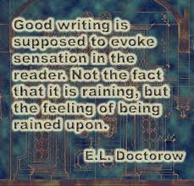
SUPPORT
The support is substantial, specific, relevant, concrete, and/or ILLUSTRATIVE.
Notes:
Illustrative & Clarity
Examples/Anecdotes/Scenarios
Imagery
Creative Writing Strategies
We will cover them in future slides
Freshness of Expression
Eliminate the obvious
Use complex, mature syntax & diction

Slide 26
The support is substantial, specific, relevant, concrete, and/or ILLUSTRATIVE.
“Don’t just say the old lady screamed; bring her on and let her scream.” Mark Twain
Before:
Anthony has long eyelashes.
After:
When Anthony strode into the room, his eyelashes cast shadows on the wall.

Slide 27
The support is substantial, specific, relevant, concrete, and/or ILLUSTRATIVE.
Real-World Writing Example:
“Then came the march past the victims. The two men were no longer alive. Their tongues were hanging out, swollen and bluish. But the third rope was still moving: the child, too light, was still breathing...And so he remained for more than half an hour, lingering between life and death, writhing before our eyes. And we were forced to look at him at close range. He was still alive when I passed him. His tongue was still red, his eyes not yet extinguished.
Behind me, I heard the same man asking:
"For God's sake, where is God?“
And from within me, I heard a voice answer:
"Where He is? This is where--hanging here from this gallows..."
That night, the soup tasted of corpses.”
― Elie Wiesel, NIGHT
Notes:
Mature diction & syntax

Slide 28
The support is substantial, specific, relevant, concrete, and/or ILLUSTRATIVE.
Student Sample:
"Sitting on my towel while the sun emanates heat and the sound of the water washes away all of my regrets, I cannot help but love where I am." (Filippone)
Notes:
Not just - I love the beach.

Slide 29
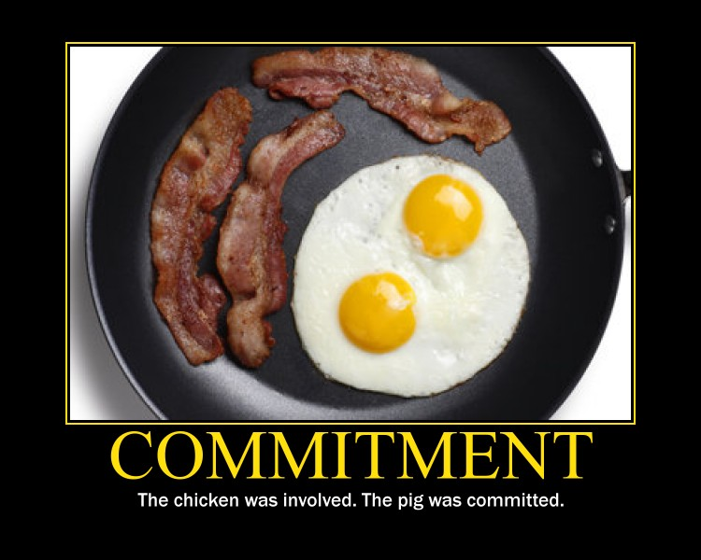
Support
The paper demonstrates a COMMITMENT to and an INVOLVEMENT with the subject, CLARITY in presentation of ideas.

Slide 30
DEMONSTRATES A COMMITMENT TO AND AN INVOLVEMENT WITH THE SUBJECT
Real-World Example:
“The day he died was one of the darkest in my life. He became sick, weak, and I was there. I was there when he suffered. I was there when he asked for help, for water. I was there to receive his last words. But I was not there when he called for me, although we were in the same block; he on the upper bed and I on the lower bed. He called my name, and I was too afraid to move. All of us were. And then he died. I was there, but I was not there.”
Elie Wiesel, SPEECH AT BUCHENWALD CONCENTRATION CAMP
Notes:
Also:
-repetition for effect ~ very persuasive technique
Ending – ended with a new insight

Slide 31
DEMONSTRATES A COMMITMENT TO AND AN INVOLVEMENT WITH THE SUBJECT
Student Samples:
“The beautiful, ear-pleasing sound floats within the room, twisting and turning this way and that, bending down to lift your spirits. Your body trembles with the amazing feeling that you get every time that wooden box opens. It never gets old, and the feelings never dull. Your eyes are glistening, and your heart is singing along with the tune.” (Kehl – Prompt: Most Prized Possession)
"I watched in horror as my mom withdrew the white bottle from my medicine cabinet. I cringed as a thick, snow-colored liquid cascaded onto my silver spoon. I gagged as my mother forced the spoon in my mouth. Although, at the age of five, how was I supposed to know that the stomach-churning liquid had saved the lives of millions? My own included." (McNaughton – Prompt: Greatest Invention)
Notes:
Diction – vivid, specific connotation
Tricolon
Parallel Structure

Slide 32
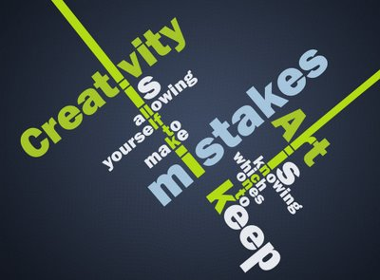
Support
The paper may use CREATIVE WRITING STRATEGIES appropriate to the purpose of the paper.
Notes:
Take a Risk ~ Make a new mistake

Slide 33
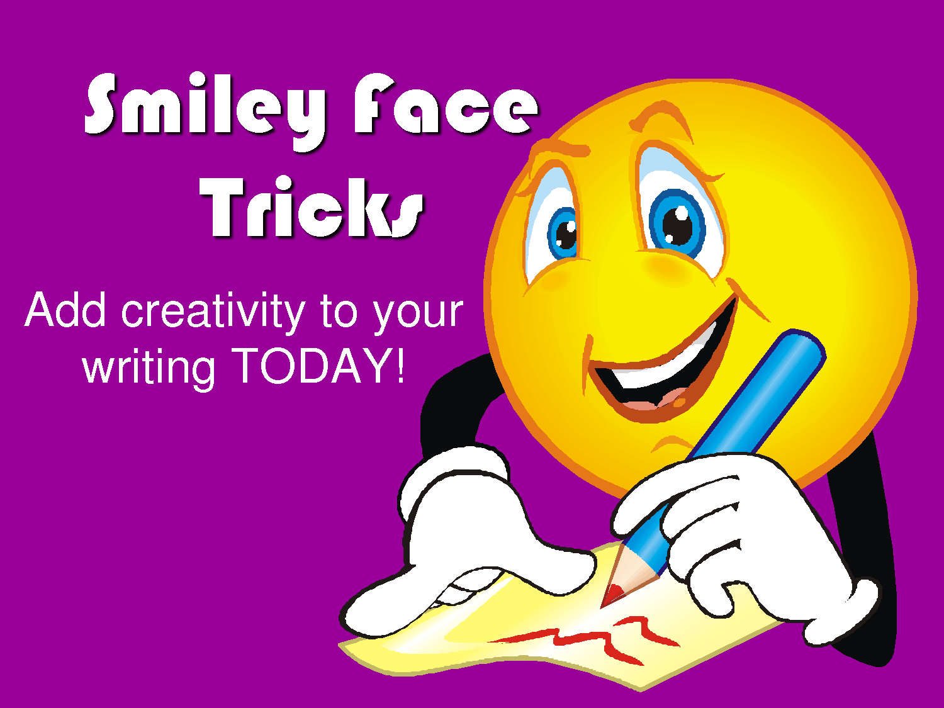
Creative Writing Strategies
Smiley–Face Tricks: Tricks of the writing trade to help you meet and exceed writing expectations.
Ideas developed by Mary Ellen Ledbetter
1. TRICOLON (Magic 3)
2. FIGURATIVE LANGUAGE
3. SPECIFIC DETAILS FOR EFFECT
4. REPETITION FOR RHETORICAL EFFECT
5. EXPANDED MOMENT
6. HUMOR
7. HYPHENATED MODIFIERS
8. FRAMING (Full-circle Ending)
Smiley-Face Tricks are tools good writers use in their writing to:
-interest the reader
-add spice to the text
-invite the reader to become more
involved with the text
-Enhance the voice of the text

Slide 34
CWS #1: Tricolon
TRICOLON: A rhetorical term for a series of three parallel words, phrases, or clauses.
Mentor Text:
“When it came flickering into his consciousness, he focused upon it, keeping it there, darkening it, holding it in his vision as long as possible until his head hurt and he let it fade away.” Lois Lowry, THE GIVER
Student Mentor:
“Headphones can be a teleportation device that move you somewhere majestic, a time machine that transports you to when things were more simplistic, a portal to an opaque, empty void where there is ample time for profound thinking and reasoning.” (DiCristina)
Notes:
-ASYNDETON

Slide 35
CWS #2: Figurative Language

Slide 36
CWS #2: Figurative Language
Non-literal comparisons add “spice” to writing and paint more vivid pictures for your readers and surprise them with unique comparisons.
Remember to brainstorm the easiest comparisons first. (She was as beautiful as a rose. She was as beautiful as a freshly bloomed flower. She was as beautiful as a model on the cover of a magazine. She was as beautiful as a star in the sky.)
Then throw those clichés away and use something fresh and original.
This technique finds new and creative ways to describe people, places, things, and ideas.
Similes—metaphors—hyperbole—personification
Notes:
Remember: Freshness of Expression
Brainstorm the obvious – then avoid them

Slide 37
Figurative Language
Mentor Text:
“The one place where a man ought to get a square deal is in a courtroom, be he any color of the rainbow, but people have a way of carrying their resentments right into a jury box. As you grow older, you'll see white men cheat black men every day of your life, but let me tell you something and don't you forget it - whenever a white man does that to a black man, no matter who he is, how rich he is, or how fine a family he comes from, that white man is trash.” Harper Lee, TO KILL A MOCKINGBIRD
Notes:
Atticus Finch

Slide 38
Figurative Language
Student Mentor:
“Your eyes are glistening, and your heart is singing along with the tune.” (Kehl)
Before:
I scratched my arm on the twig.
After:
Racing toward the house as the storm approached, I was delayed as the trees reached for me. They began to wrap their twisted arms and gnarled hands around me. I fought back, but they didn’t lessen their grip; instead, they began to screech at me as they pulled me into their grove.
Notes:
Personification
Complex diction and syntax

Slide 39
CWS #3: Specific Details for Effect
Imagery/Specific Details for Effect/Zooming In:
Instead of using general, vague descriptions or “telling” instead of “showing”, specific sensory details help your readers visualize the person, place, thing, or idea you’re writing about. You must appeal to at least 3 of the 5 senses.

Slide 40
Imagery/Specific Details for Effect/Zooming In
Before:
My grandma’s house in Mississippi is nice. (“Is nice” tells the reader about the house but doesn’t show the reader why it’s nice.)
After:
I am sitting out on an old Dixieland porch in Mississippi. The American flag waves proudly from its pole. Making itself a web in the corner of the wrought-iron railing is a small black spider. The twin rocking chairs glide back and forth, speaking to each other in the tongue of “rickety rack”. Hanging from a weeping willow, an emerald birdhouse sways in the wind, as the robins sing their never-ending song. Swooping down toward the nearby field, a crop duster exterminates the boll weevils on the cotton and turns the air a bit sour. I throw up a wave as a muddy 4 X 4 passes the farm. Down here in Mississippi we share Southern hospitality.

Slide 41
CWS #4: Repetition for Rhetorical Effect
Repetition is an effective rhetorical strategy for producing emphasis, clarity, amplification, or emotional effect.
Within the history of rhetoric, terms have been developed to name both general and very specific sorts of repetition.

Slide 42
Anaphora & Epiphora
ANAPHORA: A rhetorical device that consists of repeating a sequence of words at the beginnings of neighboring clauses, thereby lending them emphasis.
EPIPHORA: A rhetorical term for the repetition of a word or phrase at the end of successive clauses.

Slide 43
CWS: Repetition for Rhetorical Effect
Mentor Text:
"It rained on his lousy tombstone, and it rained on the grass on his stomach. It rained all over the place.“ (Holden Caulfield in J.D. Salinger's The Catcher in the Rye, 1951)
"We saw the bruised children of these fathers clump onto our school bus, we saw the abandoned children huddle in the pews at church, we saw the stunned and battered mothers begging for help at our doors.“ (Scott Russell Sanders, "Under the Influence," 1989)
“Montag had done nothing. His hand had done it all, his hand, with a brain of its own, with a conscience and a curiosity in each trembling finger, had turned thief.” (BRADBURY, FAHRENHEIT 451, )
“But I can see. I can see everything. I can see things that Mom and Dad can’t. Or won’t” (Edward Bloor, TANGERINE, 1997)
"And now when I sway to a fitful wind, alone and listing, I will think, maple key. When I see a photograph of earth from space, the planet so startlingly painterly and hung, I will think, maple key. When I shake your hand or meet your eyes I will think, two maple keys. If I am a maple key falling, at least I can twirl.“ (Annie Dillard, Pilgrim at Tinker Creek, 1974)
Notes:
ANAPHORA - repetition of word or words beginning a series of parallel syntactical units ("this sceptered isle, ... this blessed plot, this earth, this realm, this England"). ~ Jarrid Johnson’s example
~ Fragment for effect - Tangerine
Epiphora -

Slide 44
CWS: Repetition for Rhetorical Effect
Students as Mentors:
“Throughout my life, there has been one object that has assisted me through thick and thin, one object that has taught me things no one else has, one object that I cherish more than any other.” (Johnson, J)
“(Belle) is strong enough to find her father, strong enough to give her life for his, and strong enough to stand up to the Beast.”
The story of Beauty and the Beast is one of Belle defying the idea of what is normal, what is right, and what is supposed to be.

Slide 45
CWS #5: Expanded Moment
This technique involves the writer leaving the main story line to go into the character’s mind and explain a related experience or idea.
Notes:
There are times when you don’t want to EXPAND – but this is definitely a time you DO ☺

Slide 46
Expanded Moment
Mentor Text:
“Now he saw another elephant emerge from the place where it had stood hidden in the trees. Very slowly it walked to the mutilated body and looked down. With its sinuous trunk it stroked the huge corpse; then it reached up, broke some leafy branches with a snap, and draped them over the mass of torn thick flesh.
Finally it tilted its massive head, raised its trunk, and roared into the empty landscape. Jonas had never heard such a sound. It was a sound of rage and grief and it seemed never to end.” (Lois Lowry, THE GIVER)
Notes:
Imagery
Tricolon
Polysyndeton
Figurative Language: Personification

Slide 47
CWS #6: Humor
Humor: Putting his own spin on an old metaphor, Stephen Colbert once said that "Laughter brings the swelling down on our national psyche, and then applies an antibiotic cream.“
Mentor Text:
An accountant is a manila envelope yellowed with age that fell between the filing cabinet and the wall. Trapped, alone, parched.
("Battle of the Metaphors" on The Colbert Report, April 19, 2007)
Student as Mentor:
“In contrast to the hectic, chaotic, havoc-infested world, forests seem to be a place of restoration and rejuvenation. The forest’s amenities include a bubbling brook, full of red and yellow fish, but miraculously free from frogs.” (Shanks, D.)

Slide 48
Methods of Interjecting Humor
Understatement:
You know I would be a little disappointed if you were to be hit by a drunk driver at two a.m., so I hope you will be home early.
My opponents think this water is drinkable, but I'm not sure I would drink it. Perhaps they are not aware of the dangerous bacterial count . . . [and so on, explaining the basis for your opinion].

Slide 49
Methods of Interjecting Humor
Hyperbole: The counterpart of understatement, deliberately exaggerates conditions for emphasis or effect. In formal writing, the hyperbole must be clearly intended as an exaggeration, and should be carefully restricted. That is, do not exaggerate everything, but treat hyperbole like an exclamation point, to be used only once a year. Then it will be quite effective as a table-thumping attention getter, introductory to your essay or some section thereof:
Example: This stuff is used motor oil compared to the coffee you make, my love.
Mentor Text:
"He snorted and hit me in the solar plexus.
"I bent over and took hold of the room with both hands and spun it. When I had it nicely spinning I gave it a full swing and hit myself on the back of the head with the floor.“ (Raymond Chandler, "Pearls Are a Nuisance," 1939)

Slide 50
CWS #7: Hyphenated Modifiers
A technique writers use to creatively describe or rename someone or something rather than using plain one word adjectives. A boring, one-word adjective is replaced by a phrase or clause that might come to mind when the person is in that particular situation.
Mentor Text:
“He lowered a gadget over my face. In the eye of my memory, it looks like an outboard motor. I took a deep breath, and everything went black. When I woke up I was indeed allowed all the ice cream I wanted, which was a fine joke on me because I didn’t want any. My throat felt swollen and fat. But it was better than the old needle-in-the-ear trick. Oh yes. Anything would have been better than the old needle-in-the-ear trick. Take my tonsils if you have to, put a steel birdcage on my leg if you must, but God save me from the otiologist.” (Stephen King, ON WRITING)
"If nothing else works, a total pig-headed unwillingness to look facts in the face will see us through.“ (Stephen Fry as General Melchett in "Private Plane." Blackadder Goes Forth, 1989)

Slide 51
CWS #7: Hyphenated Modifiers
Student as Mentor:
“Bright-eyed, bushy-tailed, and fluttery-stomached, I tiptoed into the wondrous room, trying my best not to be noticed.” (Blankenship)

Slide 52
CWS #8: Framing/Full-Circle Ending
Framing devices are any element used at the beginning of a work that is repeated toward the end of the work to frame the story. Elements include an action, scene or event that opens and closes the work, framing it.
Read more: What Are Framing Devices? | eHow.com http://www.ehow.com/info_8724627_framing-devices.html#ixzz2LDufc62A

Slide 53
Framing/Full-Circle Ending
Mentor Text:
Beginning:
“We're adults here, most of us, and that means we look at professional athletes with a cynical, slightly jealous eye. But just like with Christmas and cartoons, if we view athletes through the eyes of a child, our whole perspective changes.”
End:
“Most times, we can be as cynical as we'd like about athletes, and most times, they'll let us down. They, like us, are human. But when we look to these players as inspirations — when we look to them as children do — every so often, they'll be everything we'd hoped they would..” (Jay Busbee, AFTER SUNDAY’S TRIBUTE, VICTOR CRUZ WILL REMAIN CONNECTED TO SANDY HOOK VICTIM’S FAMILY | Yahoo Sports– Sun, Dec 16, 2012 6:04 PM EST)
Notes:
Ending is framed – and shows a new insight

Slide 54
Framing/Full-Circle Ending
Student as Mentor:
Beginning:
“Digging my feet into the grainy, soft sand, I thought. Thought about my life, my past, my future. When I stare into the deep waters of the glistening ocean, I feel safe.”
End:
“It is so sentimental to me that I would have a hard time giving up such a gorgeous, glistening ocean.” (Bowman)

Slide 55
Support
The writing demonstrates a MATURE COMMAND OF LANGUAGE with FRESHNESS OF EXPRESSION.

Slide 56
Freshness of Expression: Asyndeton
Asyndeton: A rhetorical term for a writing style that omits conjunctions between words, phrases, or clauses.
Mentor Text:
“We were masters of nature, masters of the world. We had forgotten everything--death, fatigue, our natural needs. Stronger than cold or hunger, stronger than the shots and the desire to die, condemned and wandering, mere numbers, we were the only men on earth.” Elie Wiesel, NIGHT
“Nothing matters save the work, our secret, our evil, our precious work.” Ayn Rand, ANTHEM
Notes:
Also:
Repetition for Effect & Tricolon

Slide 57
Freshness of Expression: Polysyndeton
Polysyndeton: A rhetorical term for a sentence style that employs many coordinating conjunctions.
Mentor Text:
“Never shall I forget those moments that murdered my God and my soul and turned my dreams to ashes.” (Elie Wiesel, NIGHT)
"Let the white folks have their money and power and segregation and sarcasm and big houses and schools and lawns like carpets, and books, and mostly--mostly--let them have their whiteness.“
(Maya Angelou, I KNOW WHY THE CAGED BIRD SINGS, 1969)

Slide 58
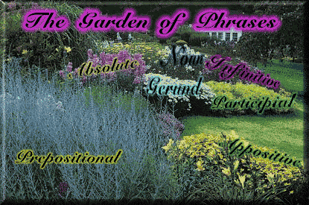
Demonstrate a Mature Command of the Language Through Syntax
Vary your syntax – use your Sentence-Composing Tools:
Phrases:

Slide 59
Demonstrate a Mature Command of the Language Through Syntax
Absolute Phrase: A sentence part describing the rest of the sentence in which it appears. Absolutes are almost complete sentences. As a test, you can make every absolute a sentence by adding was or were.
Mentor Text:
“The dragon came crashing and blundering out of the underbrush, its scales glowing a greenish copper color, its soot-caked nostrils venting smoke.” (Stephen King, The Eyes of the Dragon)

Slide 60
Syntax - Phrases
Appositive Phrase: A noun phrase identifying a person, place, or thing named in a sentence.
They always answer the questions: Who is/are…? What is/are…?
Mentor Text:
“In our clenched fists, we held our working cards from the shop, those sacred cards that we thought meant security.” (Gerda Klein, “All But My Life”)

Slide 61
Syntax: Phrases
Prepositional Phrase: A preposition is the first word in a prepositional phrase.
Mentor Text:
“In the beginning, God created the heaven and the earth.” (The Bible)
“The whole congregation prayed for me alone, in a mighty wail of moans and voices.” (Langston Hughes, THE BIG SEA)

Slide 62
Syntax: Verbals
Participial Phrase: A word group consisting of a present participle (also known as an -ing form) or past participle (also known as an -ed form), plus any modifiers, objects, and complements.
A participial phrase commonly functions as an adjective.
Participles are non-essential elements of a sentence; therefore, participles are removable.
Mentor Text:
“The men within the door stared at one another, shifting on their boots, twiddling their fingers, and holding onto their hip belts.” (Ray Bradbury, The Martian Chronicles)
Notes:
tricolon

Slide 63
Syntax: Verbals
Gerund Phrase: A traditional grammatical term for a verbal that ends in -ing and functions as a noun.
The gerund, its object and all modifiers (adjectives and adverbs) are known as a gerund phrase.
Unlike a present participle, gerunds are essential elements and may not be removed.
Mentor Text:
“Extracting bullets and treating knife wounds were routine procedures, and Eliza lost her horror of blood and learned to stitch human flesh as calmly as formerly she had embroidered sheets for her trousseau.” (Isabel Allende, Daughter of Fortune)
“ In the process of gaining our rightful place we must not be guilty of wrongful deeds.” (Martin Luther King, Jr., “I Have a Dream”)
Read more at http://www.grammar-monster.com/glossary/gerund_phrase.htm#Tp6uz0EC0DxW3HxF.99
Notes:
Subject noun & object of the preposition

Slide 64
Syntax: Verbals
Infinitive Phrase: A verbal construction made up of the particle to and the base form of a verb, with or without modifiers and objects.
An infinitive phrase can function as a noun, an adjective, or an adverb.
Mentor Text:
“At nine o’clock Earth started to explode, to catch fire, and to burn.” (noun infinitives-name what started) Ray Bradbury, The Martian Chronicles
“It was the time to accomplish his mission or to fail.” (adjective infinitives-describe the time) Myers, Legend of Tarik
“She lingered a moment or two to bathe her own face with the cool water and to smooth her hair. (adverb infinitives-state the reason she lingered) Leroux, The Phantom of the Opera

Slide 65
Syntax: Dependent Clauses
Clauses are groups of words containing subject and verbs.
Dependent Clauses: A group of words that has both a subject and a verb but (unlike an independent clause) cannot stand alone as a sentence. Also known as a subordinate clause.
Dependent clauses include adverb clauses, adjective clauses, and noun clauses.
Noun clauses are essential to the sentence.
Adjective clauses and adverb clauses are nonessential elements and may be removed.

Slide 66
Syntax: Dependent Clauses
Adjective Clauses: A dependent clause that describes a person, place, or thing.
Mentor Texts:
“To Richardson, whose nerves were tingling and twitching like live wires, and whose heart jolted inside him, this pause was a long horror.” Stephen Crane, “Horses-One Dash”
“She failed to see a shadow, which followed her like her own shadow, which stopped when she stopped, and which started again when she did.” Gaston Leroux, The Phantom of the Opera

Slide 67
Fragments for Effect
In both fiction and nonfiction, the sentence fragment may be used deliberately to create a variety of powerful effects.
Mentor Text:
Midway through J. M. Coetzee's novel Disgrace (Secker & Warburg, 1999), the main character experiences shock as the result of a brutal attack at his daughter's house. After the intruders leave, he attempts to come to terms with what has just occurred:
“It happens every day, every hour, every minute, he tells himself, in every quarter of the country. Count yourself lucky to have escaped with your life. Count yourself lucky not to be a prisoner in the car at this moment, speeding away, or at the bottom of a donga with a bullet in your head. Count Lucy lucky too. Above all Lucy.
A risk to own anything: a car, a pair of shoes, a packet of cigarettes. Not enough to go around. not enough cars, shoes, cigarettes. Too many people, too few things. What there is must go into circulation, so that everyone can have a chance to be happy for a day. That is the theory; hold to this theory and to the comforts of theory. Not human evil, just a vast circulatory system, to whose workings pity and terror are irrelevant. That is how one must see life in this country: in its schematic aspect. Otherwise one could go mad. Cars, shoes; women too. There must be some niche in the system for women and what happens to them.”
In this passage, the fragments (in italics) reflect the character's efforts to make sense of the harsh, disruptive experience. The sense of incompleteness conveyed by the fragments is deliberate and quite effective.

Slide 68
Syntax: Adverb Clause
Adverb Clause: A dependent clause used as an adverb within a sentence to indicate time, place, condition, contrast, concession, reason, purpose, or result. Also known as adverbial clause.
An adverb clause begins with a subordinating conjunction (such as if, when, because, or although) and includes a subject and a predicate.
Mentor Text:
“As her soared upward, as the wind rushed through his hair, as the crowd’s faces became mere flesh-colored pinpricks below, and as the Horntail shrank to the size of the dog, he realized that he had left not only the ground behind, but also his fear.

Slide 69
Diction
Points to Remember:
Use academic diction
Keep it natural
Write out most contractions
Avoid the obvious
Takes risks – play with your diction within complex syntax
Connotation is your friend
Choose the RIGHT word – on PURPOSE

Slide 70
Diction Matters

Slide 71
Conventions

Slide 72
Conventions: Comma Rules
Comma Rules – From the Experts
Try this experiment: Give your instructor five dollars for each comma you use in an essay. Your instructor will return five dollars for each comma used correctly. You should come out even. This technique is heartily endorsed by English teachers everywhere.

Slide 73
Conventions

Slide 74
Fragments for Effect
Student as Mentor:
Intro:
“Walking down the crowded streets, camera in hand, I look for subjects to photograph. There is a tree standing alone, blowing in the breeze. A woman crying. A family laughing. Rays of sunshine bursting through the clouds. Signs of hope and love, but also of solitude and sadness. These images can transcend the borders of time and language. They are bursting with emotion. They tell a story. A camera can open up a whole new world, producing a picture that is worth a thousand words.”
Conclusion:
“The tree blowing in the breeze? It was planted by a couple celebrating their fiftieth wedding anniversary today. The woman crying? Her mother just lost her battle against breast cancer. The family laughing? They are adopting a newborn baby from China in a few months. The rays of sunshine breaking through the clouds? They are a sign from God telling a girl to hold on for one more day. These photographs can make you feel every emotion. They can evoke you to create a story for every picture. And they can be understood not matter where you are from. A picture is worth a thousand words? More like millions.” (Mitchell)
Notes:
Transitions:
-absence of transitions adds, rather than detracts, from the piece
-together with varied sentence length, adds “punch” to the piece
To make better:
Parallel structure – in conclusion. They “are adopting” should be made past tense to keep parallel tenses.
Awkward sentence – “They can evoke you to create a story for every picture.”
Conclusion: reveal new insight

Slide 75
Name the Literary Device
"We gain strength, and courage, and confidence by each experience in which we really stop to look fear in the face...we must do that which we think we cannot."
Eleanor Roosevelt
(1884-1962)
Notes:
Polysyndeton

